Slide 1

Lab 6: Picket Fence Free Fall
St. Petersburg College

Slide 2
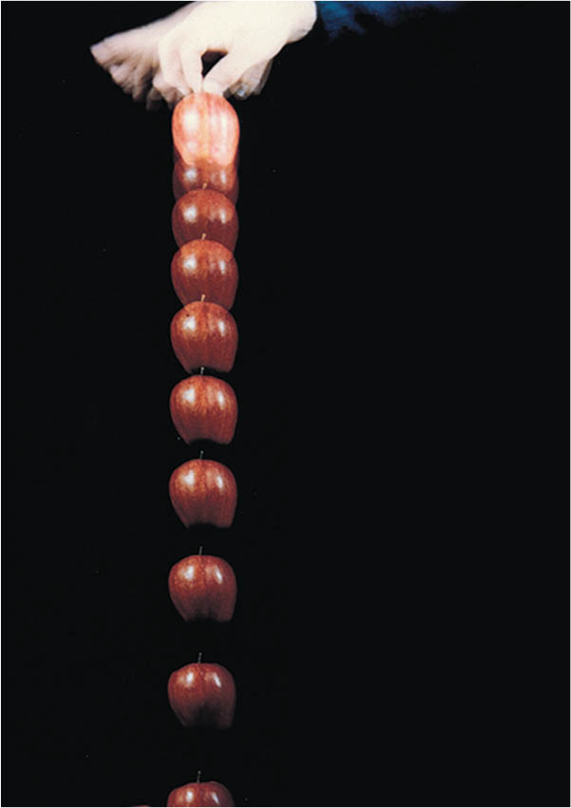
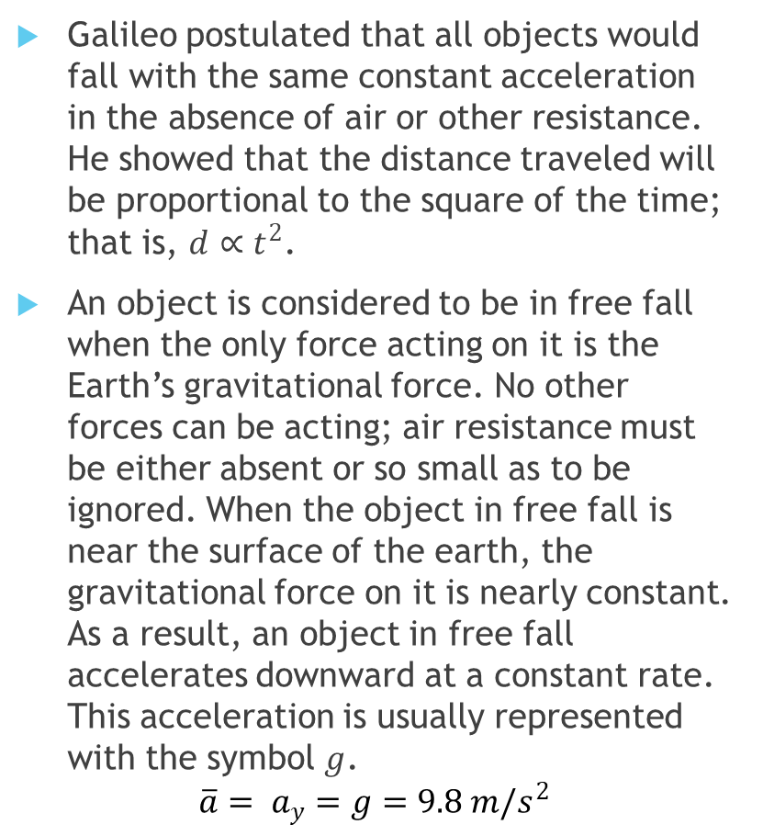
Introduction
Galileo postulated that all objects would fall with the same constant acceleration in the absence of air or other resistance. He showed that the distance traveled will be proportional to the square of the time; that is, $d∝t^{2}$.
An object is considered to be in free fall when the only force acting on it is the Earth’s gravitational force. No other forces can be acting; air resistance must be either absent or so small as to be ignored. When the object in free fall is near the surface of the earth, the gravitational force on it is nearly constant. As a result, an object in free fall accelerates downward at a constant rate. This acceleration is usually represented with the symbol $g$.
$$\overline{a}= a_{y}=g=9.8 m/s^{2}$$

Slide 3
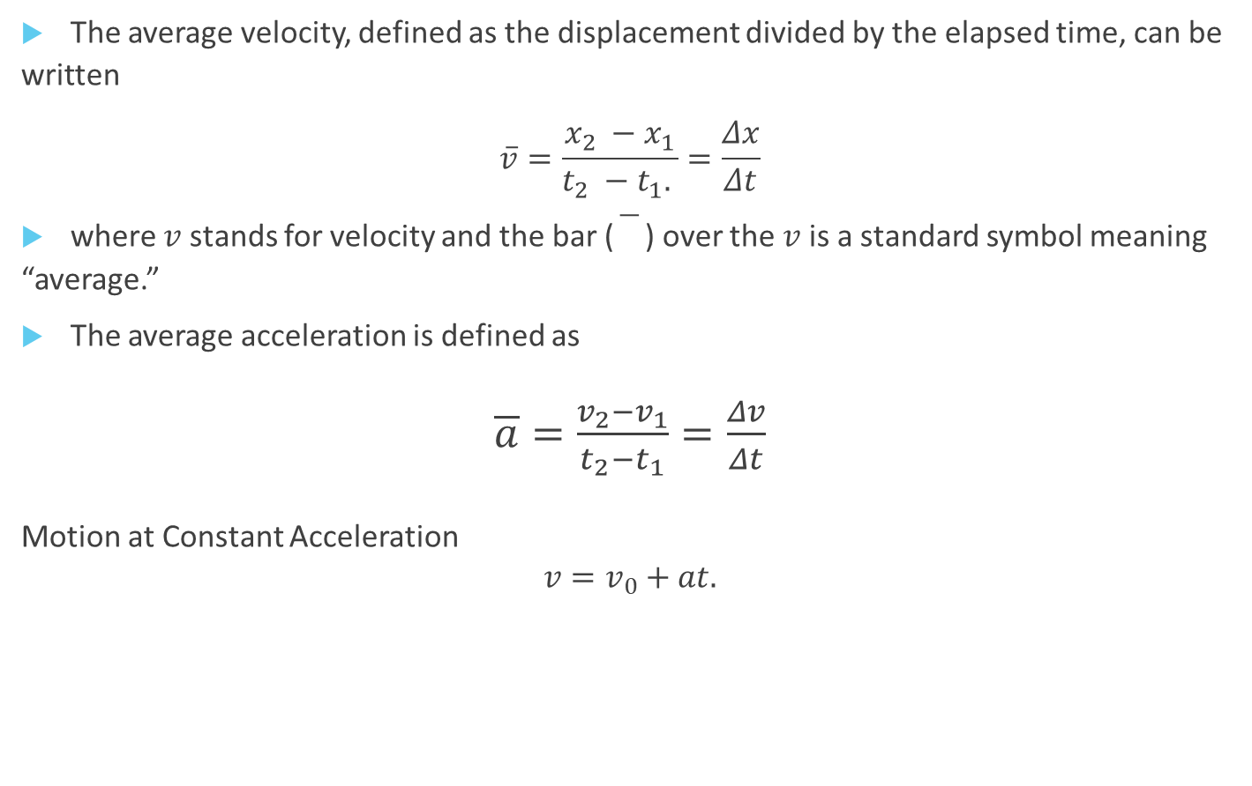
Introduction, Cont.
The average velocity, defined as the displacement divided by the elapsed time, can be written
$$\overline{v}=\frac{x_{2} −x_{1}}{t_{2} −t_{1}. }=\frac{Δx}{Δt}$$
where $v$ stands for velocity and the bar () over the $v$is a standard symbol meaning “average.”
The average acceleration is defined as
$\overline{a}=\frac{v_{2}−v_{1}}{t_{2}−t_{1}}=\frac{Δv}{Δt}$
Motion at Constant Acceleration
$$v=v_{0}+at.$$

Slide 4
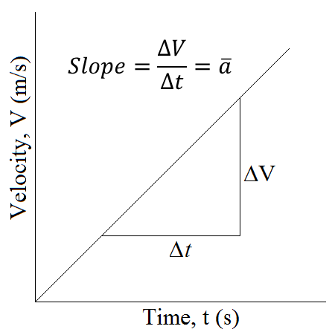
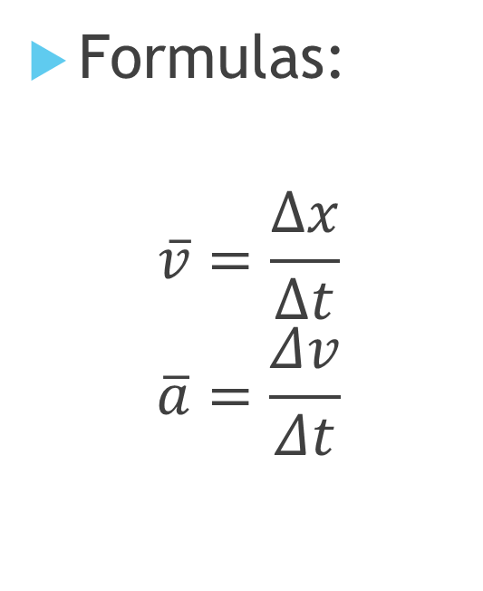
Introduction, Continued
Formulas:
$$\overline{v}=\frac{∆x}{∆t}$$
$$\overline{a}=\frac{Δv}{Δt}$$

Slide 5

Objective
Measure the acceleration of a freely falling body (g) using a Picket Fence and a Photogate.
Computer with Logger Pro | Vernier Photogate
LabPro with accessories | Picket Fence
clamp or ring stand to secure Photogate | Carpet

Slide 6
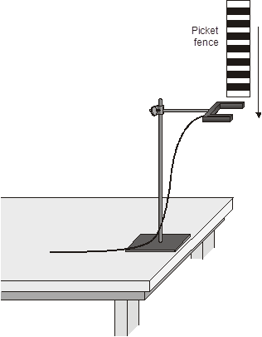
Picket Fence
In this experiment, you will use a very precise timer connected to the computer and a Photogate. The Photogate has a beam of infrared light that travels from one side to the other. It can detect whenever this beam is blocked. You will drop a piece of clear plastic with evenly spaced black bars on it, called a Picket Fence. As the Picket Fence passes through the Photogate, the computer will measure the time from the leading edge of one bar blocking the beam until the leading edge of the next bar blocks the beam. This timing continues as all eight bars pass through the Photogate. From these measured times, the program will calculate the velocities and accelerations for this motion and graphs will be plotted.

Slide 7
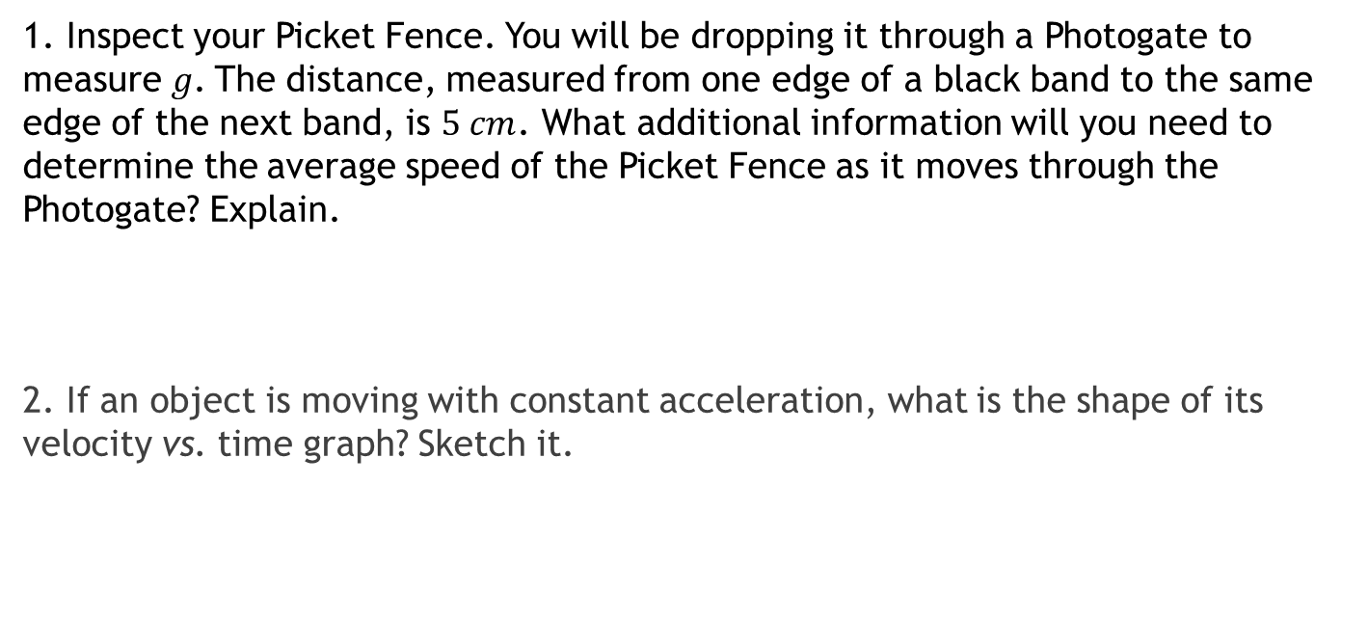
Preliminary questions
1. Inspect your Picket Fence. You will be dropping it through a Photogate to measure$g$. The distance, measured from one edge of a black band to the same edge of the next band, is $5 cm$. What additional information will you need to determine the average speed of the Picket Fence as it moves through the Photogate? Explain.
2. If an object is moving with constant acceleration, what is the shape of its velocity vs. time graph? Sketch it.

Slide 8

Procedure
1. Fasten the Photogate rigidly to a ring stand so the arms extend horizontally, as shown in Figure 1. The entire length of the Picket Fence must be able to fall freely through the Photogate. To avoid damaging the Picket Fence, make sure it has a soft surface (such as a carpet) to land on.
2. Connect the Photogate to the DIG/SONIC 1 input of the Vernier computer interface.
3. Look for Logger Pro on desktop and open.
→ file → open → physics with computer
Open the file “05 Picket Fence” in the Physics with Vernier folder.
4. Observe the reading in the status bar of Logger Pro at the top of the screen. Block the Photogate with your hand; note that the Gate State is shown as Blocked. Remove your hand and the display should change to Unblocked.
5. Click to prepare the Photogate. Hold the top of the Picket Fence and drop it through the Photogate, releasing it from your grasp completely before it enters the Photogate. Be careful when releasing the Picket Fence. It must not touch the sides of the Photogate as it falls and it needs to remain vertical. Click to end data collection.

Slide 9
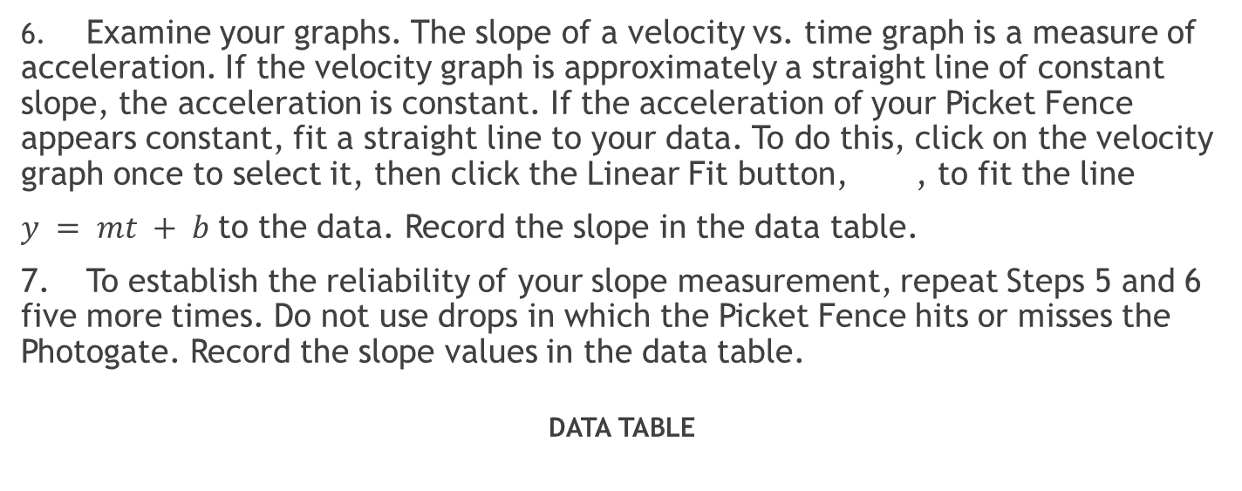
Procedure, Cont
6. Examine your graphs. The slope of a velocity vs. time graph is a measure of acceleration. If the velocity graph is approximately a straight line of constant slope, the acceleration is constant. If the acceleration of your Picket Fence appears constant, fit a straight line to your data. To do this, click on the velocity graph once to select it, then click the Linear Fit button, , to fit the line
$y = mt + b$to the data. Record the slope in the data table.
7. To establish the reliability of your slope measurement, repeat Steps 5 and 6 five more times. Do not use drops in which the Picket Fence hits or misses the Photogate. Record the slope values in the data table.
DATA TABLE
Trial | 1 | 2 | 3 | 4 | 5 | 6
Slope ( )

Slide 10

Analysis
1. From your six trials, determine the minimum, maximum, and average values for the acceleration of the Picket Fence. Record them in the data table below.
2. Describe in words and sketch the shape of the position vs. time graph for the free fall.
3. Describe in words and sketch the shape of the velocity vs. time graph. How is this related to the shape of the position vs. time graph?

Slide 11
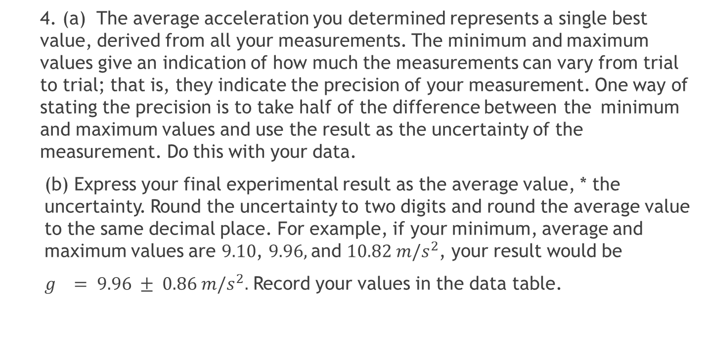
Analysis, Cont
  4. (a) The average acceleration you determined represents a single best value, derived from all your measurements. The minimum and maximum values give an indication of how much the measurements can vary from trial to trial; that is, they indicate the precision of your measurement. One way of stating the precision is to take half of the difference between the minimum and maximum values and use the result as the uncertainty of the measurement. Do this with your data.
(b) Express your final experimental result as the average value, * the uncertainty. Round the uncertainty to two digits and round the average value to the same decimal place. For example, if your minimum, average and maximum values are $9.10$, $9.96,$and $10.82 m/s^{2}$, your result would be
$g = 9.96 ± 0.86 m/s^{2}.$ Record your values in the data table.

Slide 12

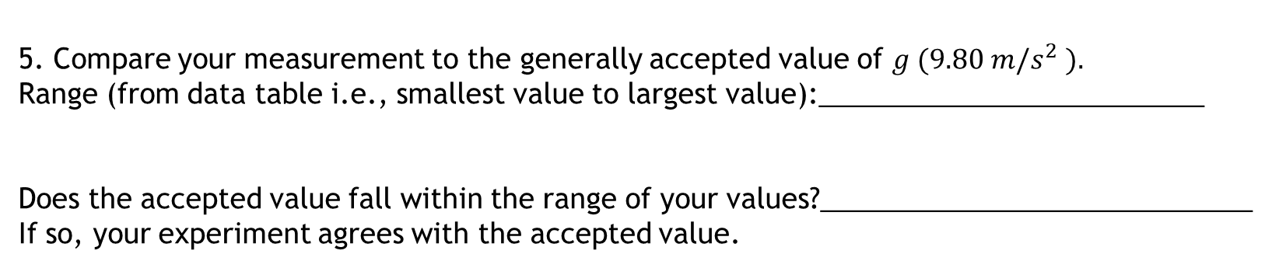
Analysis, Continued.
(e) Express the uncertainty as a percentage of the acceleration. This is the precision of your experiment. Using the example numbers from the last step, the precision would be:
Acceleration due to gravity, g + uncertainty [See 4(c) on next pg.] | ± ( )
Precision [See 4(e) on next pg.] | %
The uncertainty is: ____________________________________
5. Compare your measurement to the generally accepted value of $g (9.80 m/s^{2} ).$
Range (from data table i.e., smallest value to largest value):_________________________
Does the accepted value fall within the range of your values?____________________________
If so, your experiment agrees with the accepted value.

Slide 13
Analysis, Cont.
6. Inspect your velocity graph. How would the associated acceleration vs. time graph look? Sketch your prediction.
7. Now change the upper graph to acceleration vs. time. Do this by clicking on the y-axis label. Select Acceleration. Comment on any differences. You may want to rescale the graph so that the acceleration axis begins at zero.
8.
a. Describe one random error encountered in this lab. State explicitly why it is a random error.
b. Describe one systematic error encountered in this lab. State explicitly why it is a systematic error.

